Slide 1
Chapter 10:
Introduction to Inheritance

Slide 2
Objectives
Learn about inheritance.
Extend classes.
Use the protected access specifier.
Override base class members.
Understand how a derived class object “is an” instance of the base class.
Learn about the Object class.
Work with base class constructors.

Slide 3
Objectives
Create and use abstract classes.
Create and use interfaces.
Use extension methods.
Recognize inheritance in GUI applications and understand the benefits of inheritance.

Slide 4
Understanding Inheritance
Inheritance is the principle that you can apply knowledge of a general category to more specific objects.
Advantages of inheritance:
Saves time.
Reduces the chance of errors.
Makes it easier to understand the inherited class.
Makes programs easier to write.

Slide 5
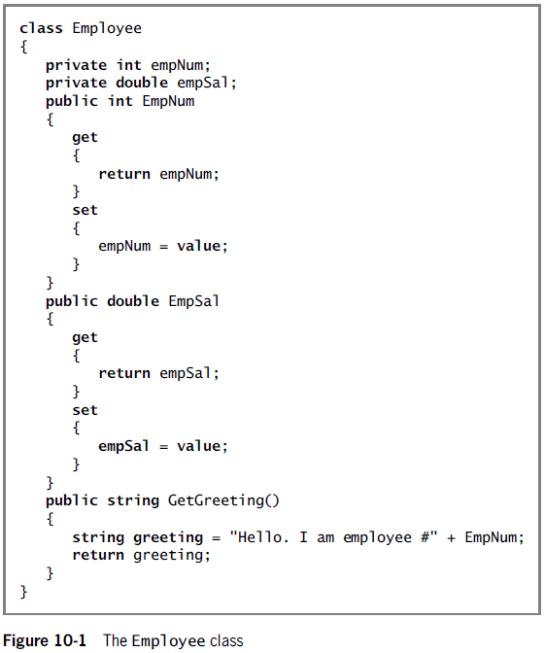

Slide 6
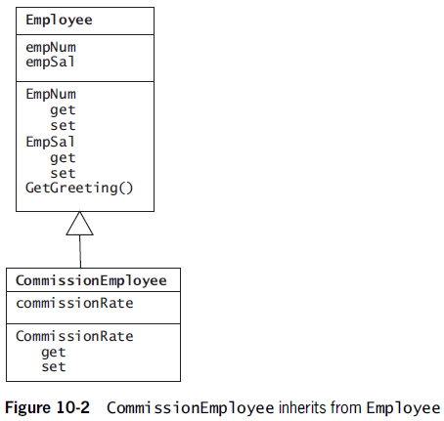
Understanding Inheritance

Slide 7
Understanding Inheritance Terminology
A class that is used as a basis for inheritance is called a base class.
Also known as the superclass or parent class.
When you create a class that inherits from a base class, it is a derived class or extended class.
A derived class always “is a” case or an instance of the more general base class.
Also referred to as a subclass or child class.

Slide 8
Understanding Inheritance Terminology
A list of parent classes from which a child class is derived constitutes the ancestors of the subclass.
Inheritance is transitive which means a child inherits all the members of all its ancestors.
In other words, when you crate an object, it contains all the attributes and methods of the ancestors.

Slide 9
Extending Classes
Use a single colon between the derived class name and its base class name.
Inheritance works only in one direction – a child inherits from a parent.
Never visa-versa.

Slide 10
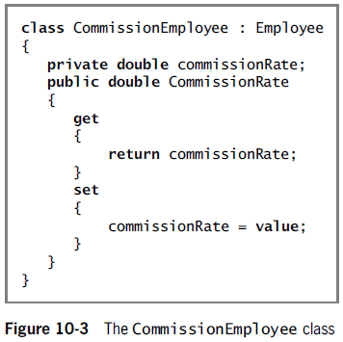
Extending Classes

Slide 11
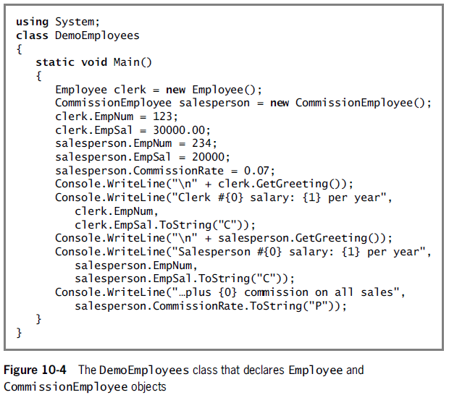
Extending Classes

Slide 12
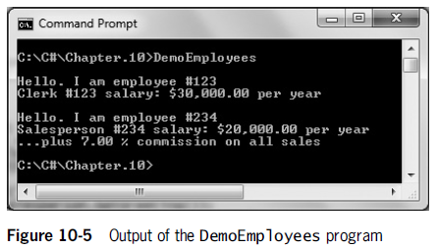
Extending Classes

Slide 13
Using the protected Access Specifier
Any derived class inherits all the data and methods of its base class – including private data and methods.
You cannot use or modify private data and methods directly.
A protected data field or method can be used within its own class or in any classes extended from that class.
However, it cannot be used by “outside” classes.
protected methods should be used sparingly.

Slide 14
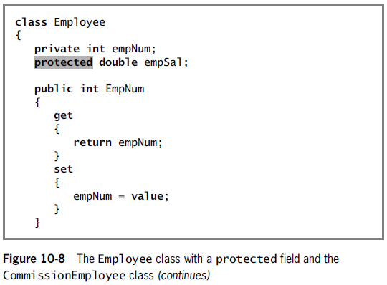
Using the protected Access Specifier

Slide 15
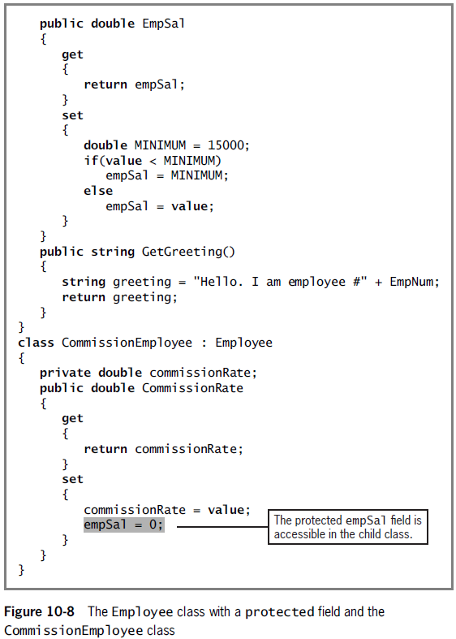

Slide 16
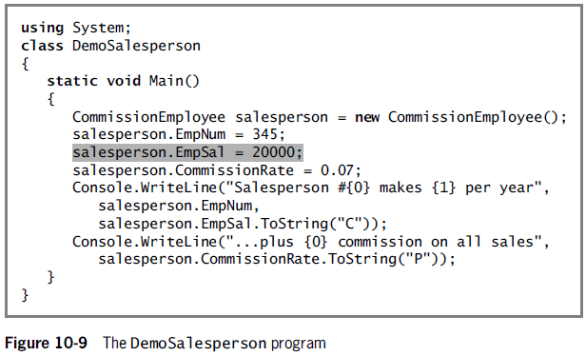
Using the protected Access Specifier

Slide 17
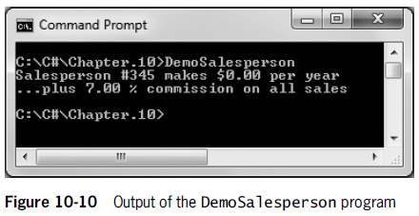
Using the protected Access Specifier

Slide 18
Overriding Base Class Methods
Again, a derived class contains data and methods defined in the original class.
Sometimes, the superclass fields, properties, and methods are not entirely appropriate for the subclass objects.
Using the same method or property name to indicate different implementations is called polymorphism.
A virtual method (or property) is one that can be overridden by a method with the same signature (name) in a child class.

Slide 19
Overriding Base Class Methods
A derived class can override and hide methods and data from the base class.
If a base class and a derived class have methods with the same names but different parameter list, the derived class method does not override the base class method.
Instead, it overloads the base class method.

Slide 20
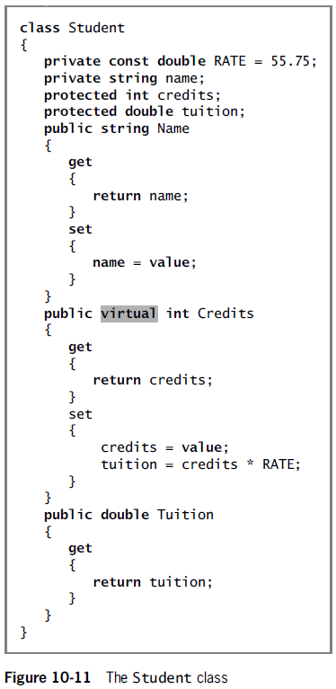

Slide 21
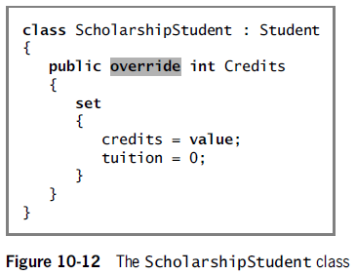
Overriding Base Class Methods

Slide 22
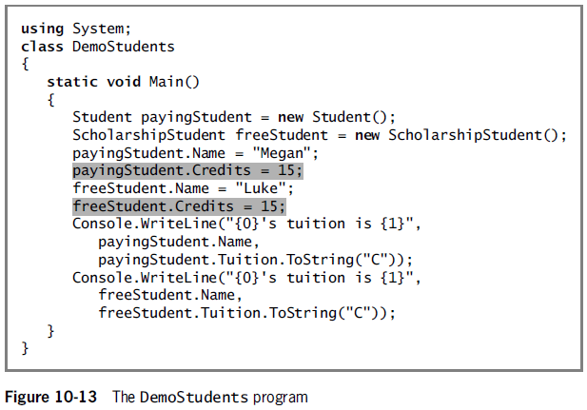
Overriding Base Class Methods

Slide 23
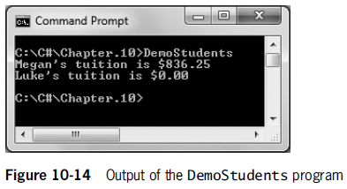
Overriding Base Class Methods

Slide 24
Accessing Base Class Methods and Properties from a Derived Class
When a derived class contains a method or property that overrides a parent class method or property, you might have occasion to use the parent class version within the subclass.
If so, you can use the keyword base to access the parent class method or property.

Slide 25
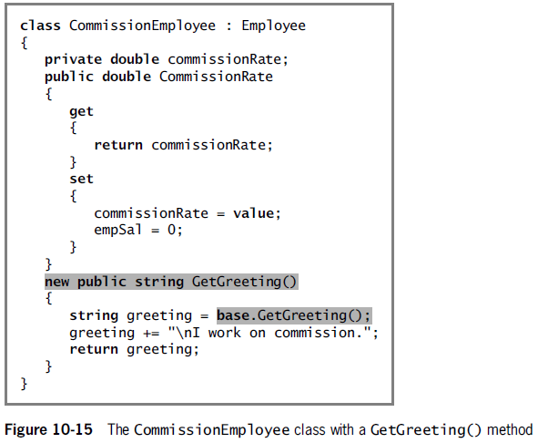
Accessing Base Class Methods and Properties from a Derived Class

Slide 26
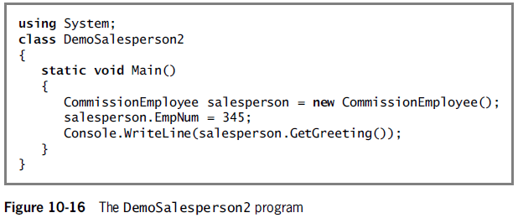
Accessing Base Class Methods and Properties from a Derived Class

Slide 27
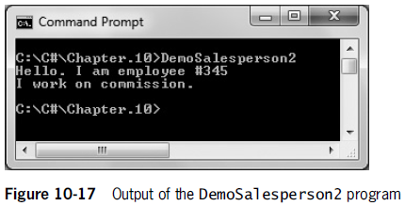
Accessing Base Class Methods and Properties from a Derived Class

Slide 28
Understanding Implicit Reference Conversions
Every derived class object “is a” specific instance of both the derived class and the base class.
You can assign a derived class object to an object of any of its superclass types.
When you do, C# makes an implicit conversion from the derived class to the base class.

Slide 29
Understanding Implicit Reference Conversions
When a derived class object is assigned to its ancestor’s data type, the conversion can more specifically called an implicit reference conversion.
The term is more accurate because it emphasizes the difference between numerical conversions and reference objects.

Slide 30
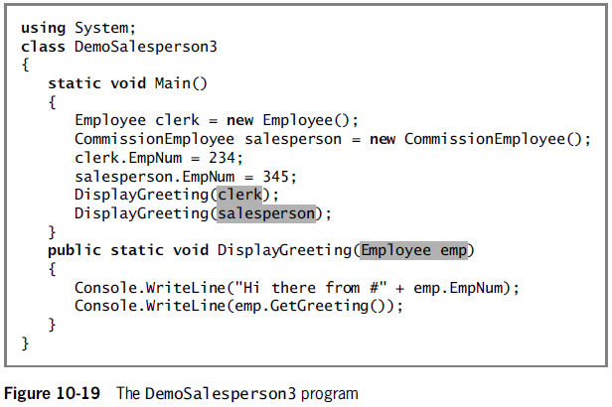
Understanding Implicit Reference Conversions

Slide 31
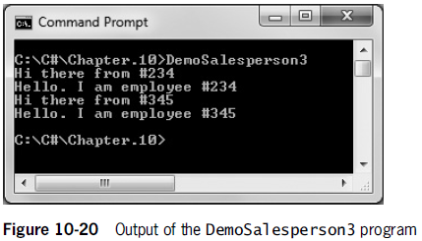
Understanding Implicit Reference Conversions

Slide 32
Using the Object Class
Every class you create in C# derives from a single class named System.Object.
In other words, the object (or Object) class type in the System namespace is the ultimate base class or root class for all other types.
The keyword object is an alias for the System.Object class.

Slide 33
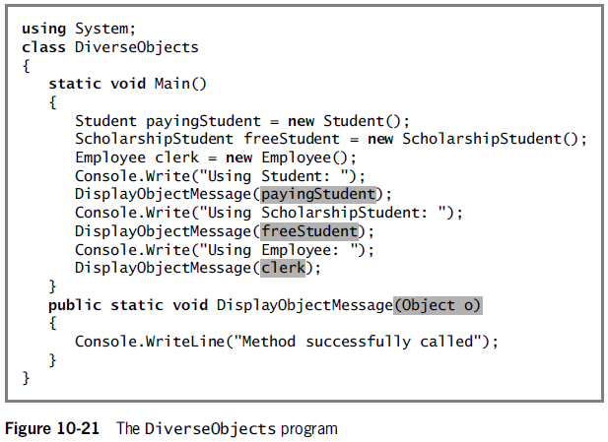
Using the Object Class

Slide 34
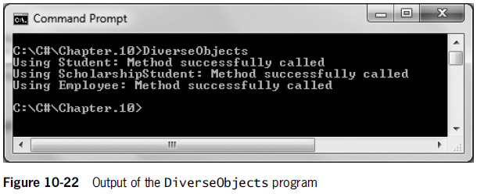
Using the Object Class

Slide 35
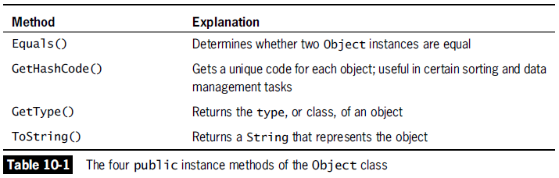
Using the Object Class

Slide 36
Using the Object Class’s GetType() Method
The GetType() method returns an object’s type, or class.
Console.WriteLine(someWorker.GetType());
If an object’s class is defined in a namespace, the getType() returns a string composed of the namespace, a dot, and the class name.

Slide 37
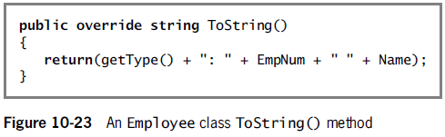
Using the Object Class’s ToString() Method
The ToString() method returns a string that holds the class name – just as GetType() does.
When you create a class, you often want to override the Object class’s ToString method with you own, more useful version.

Slide 38
Using the Object Class’s Equals() Method
The Equals() method compares objects for reference equality.
Reference equality occurs when two reference type objects refer to the same object.
The Equals() method returns true if two Objects have the same memory address.
That is, if one object is a reference to the other and both are literally the same object.

Slide 39
Using the Object Class’s Equals() Method
You might want to override the Equals() method for any class you create if you anticipate that class clients will want to compare objects based on any of their field values.
If you overload the Equals() method, it should meet the following requirements by convention:
The header should be:
public override bool Equals(Object o)
It should return false if the argument is null.
It should return true if an object is compared to itself.

Slide 40
Using the Object Class’s Equals() Method
Requirements continued:
It should return true only if both of the following are true:
oneObject.Equals(anotherObject)
anotherObject.Equals(oneObject)
If oneObject.Equals(anotherObject)returns true and oneObject.Equals(aThirdObject)returns true, then anotherObject.Equals(aThirdObject)should also return true.

Slide 41
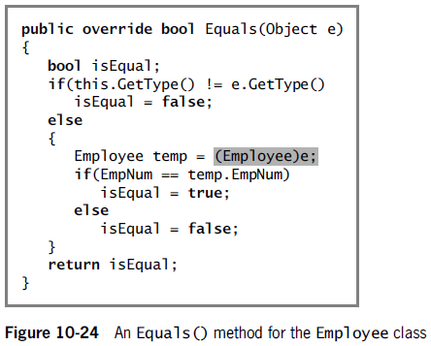
Using the Object Class’s Equals() Method

Slide 42
Using the Object Class’s GetHashCode() Method
When you override the Equals() method, you also override the GetHashCode() method because Equals() uses GetHashCode() and two objects considered equal should have the same hash code.
A hash code is a number that uniquely identifies an object.

Slide 43
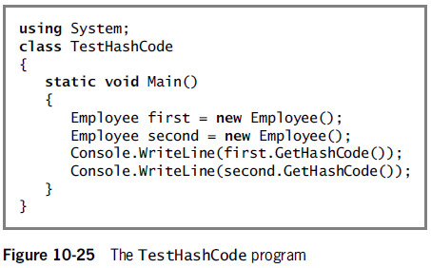
Using the Object Class’s GetHashCode() Method

Slide 44
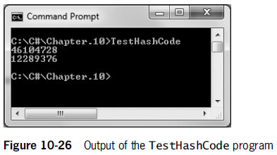
Using the Object Class’s GetHashCode() Method

Slide 45
Working with Base Class Constructors
When you create any object, you automatically call a constructor that has the same name as the class itself.
When you instantiate an object that is a member derived class, you call the constructor for both the base class and the derived class.
When you create any derived class object, the base class constructor must execute first; only then does the derived class constructor execute.

Slide 46
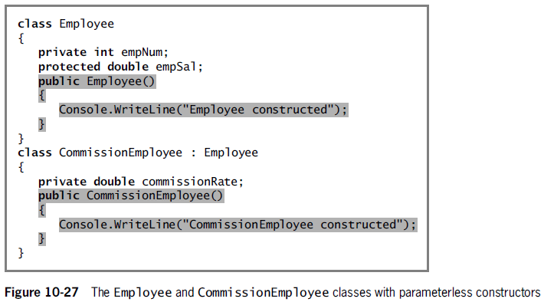
Working with Base Class Constructors

Slide 47
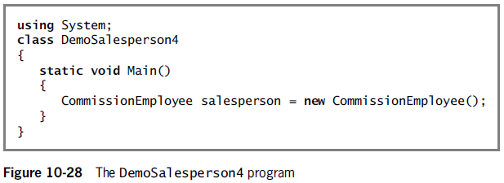
Working with Base Class Constructors

Slide 48
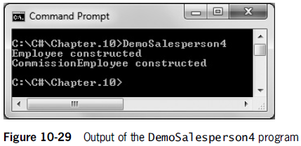
Working with Base Class Constructors

Slide 49
Using Base Class Constructors That Require Arguments
When a base class constructor requires arguments, include a constructor for each derived class you create.
The derived class constructor can contain any number of statements.
Within the header, provide values for any arguments required by the base class constructor using the keyword base.
public CommissionEmployee() : base(1234, "XXXX")

Slide 50
Creating and Using Abstract Classes
An abstract class is one from which you cannot create concrete objects, but from which you can inherit.
Use the keyword abstract when you declare an abstract class.
Abstract classes usually contain abstract methods, although methods are not required.
An abstract method has no method statements.
A derived classes must override it using the keyword override.

Slide 51
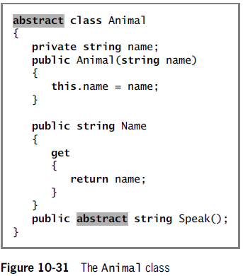
Creating and Using Abstract Classes

Slide 52
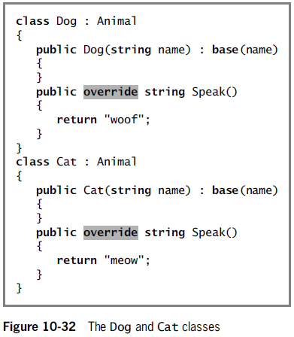
Creating and Using Abstract Classes

Slide 53
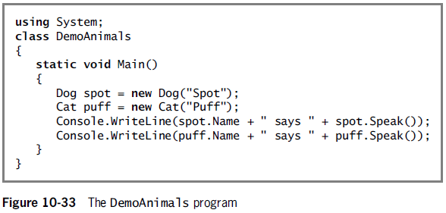
Creating and Using Abstract Classes

Slide 54
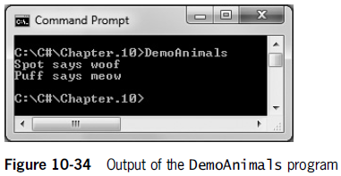
Creating and Using Abstract Classes

Slide 55
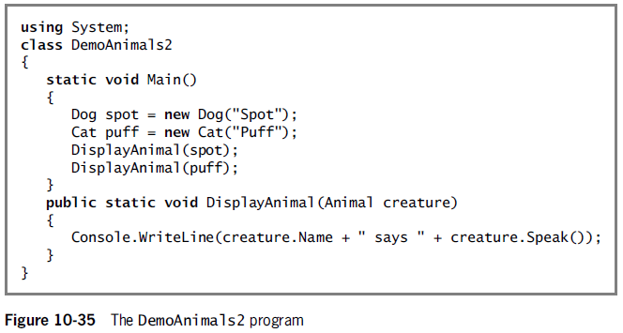
Creating and Using Abstract Classes

Slide 56
Creating and Using Interfaces
The ability to inherit from more than one class is called multiple inheritance.
Multiple inheritance is a difficult concept and programmers encounter problems when they use it.
For this reason, multiple inheritance is prohibited in the C# programming language.

Slide 57
Creating and Using Interfaces
However, C# does provide an alternative to multiple inheritance, known as interface.
Interface is a collection of methods (and perhaps other members) that can be used by any class as long as the class provides a definition to override the interface’s abstract definitions.
In an abstract class, not all methods need to be abstract – however, in an interface, all methods are abstract.

Slide 58
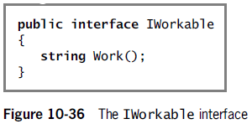
Creating and Using Interfaces

Slide 59
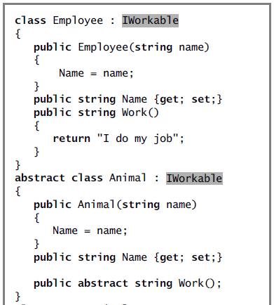
(continues)

Slide 60
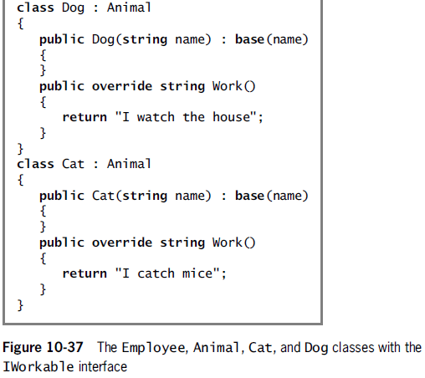

Slide 61
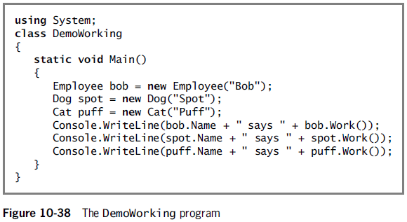
Creating and Using Interfaces

Slide 62
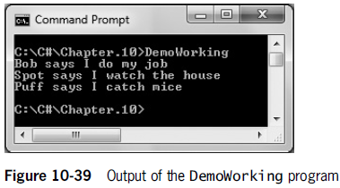
Creating and Using Interfaces

Slide 63
Creating and Using Interfaces
You cannot instantiate concrete objects from either abstract classes or interfaces.
A class can inherit from only one base class.
However, it can implement any number of interfaces.
You create an interface when you want derived classes to override every method in the base class.
Interfaces provide you with a way to exhibit polymorphic behavior.

Slide 64
Using Extension Methods
Extension methods are methods you can write to add to any type.
The first parameter in an extension method specifies the type extended and must begin with the this keyword.
When you write an extension method, it must be stored in a static class.

Slide 65
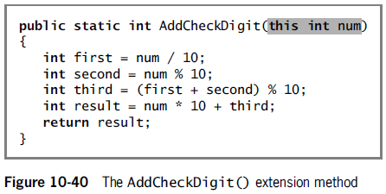
Using Extension Methods

Slide 66
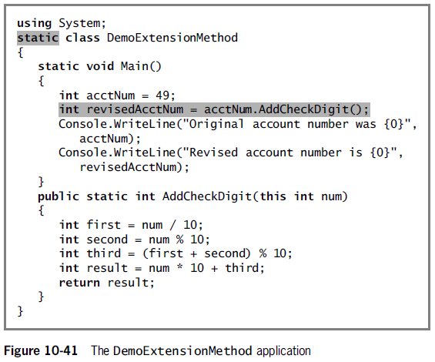
Using Extension Methods

Slide 67
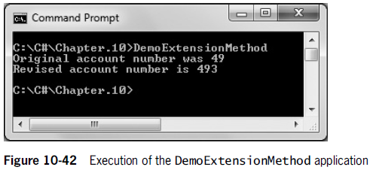
Using Extension Methods

Slide 68
Recognizing Inheritance in GUI Applications and Recapping the Benefits of Inheritance
When you create a Windows Forms Application using Visual Studio’s IDE, you automatically use inheritance.
Every Form you create is a descendent of the Form class.

Slide 69
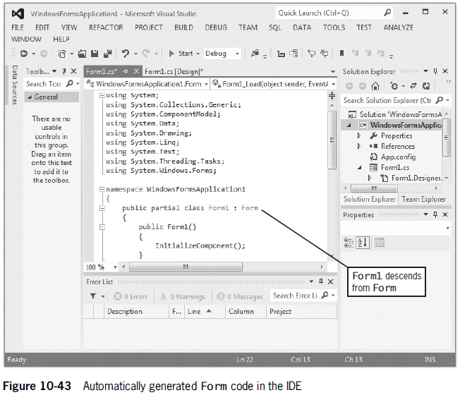

Slide 70
Recognizing Inheritance in GUI Applications and Recapping the Benefits of Inheritance
When you create a useful, extendable base class, you gain several advantages:
Derived class creators save development time because much of the code that is needed for the class already has been written.
Derived class creators save testing time because the base class code already has been tested.
The amount of time to learn the new class features is reduced.
The base class source code is not changed, therefore, the base class maintains its integrity.

